Slide 1


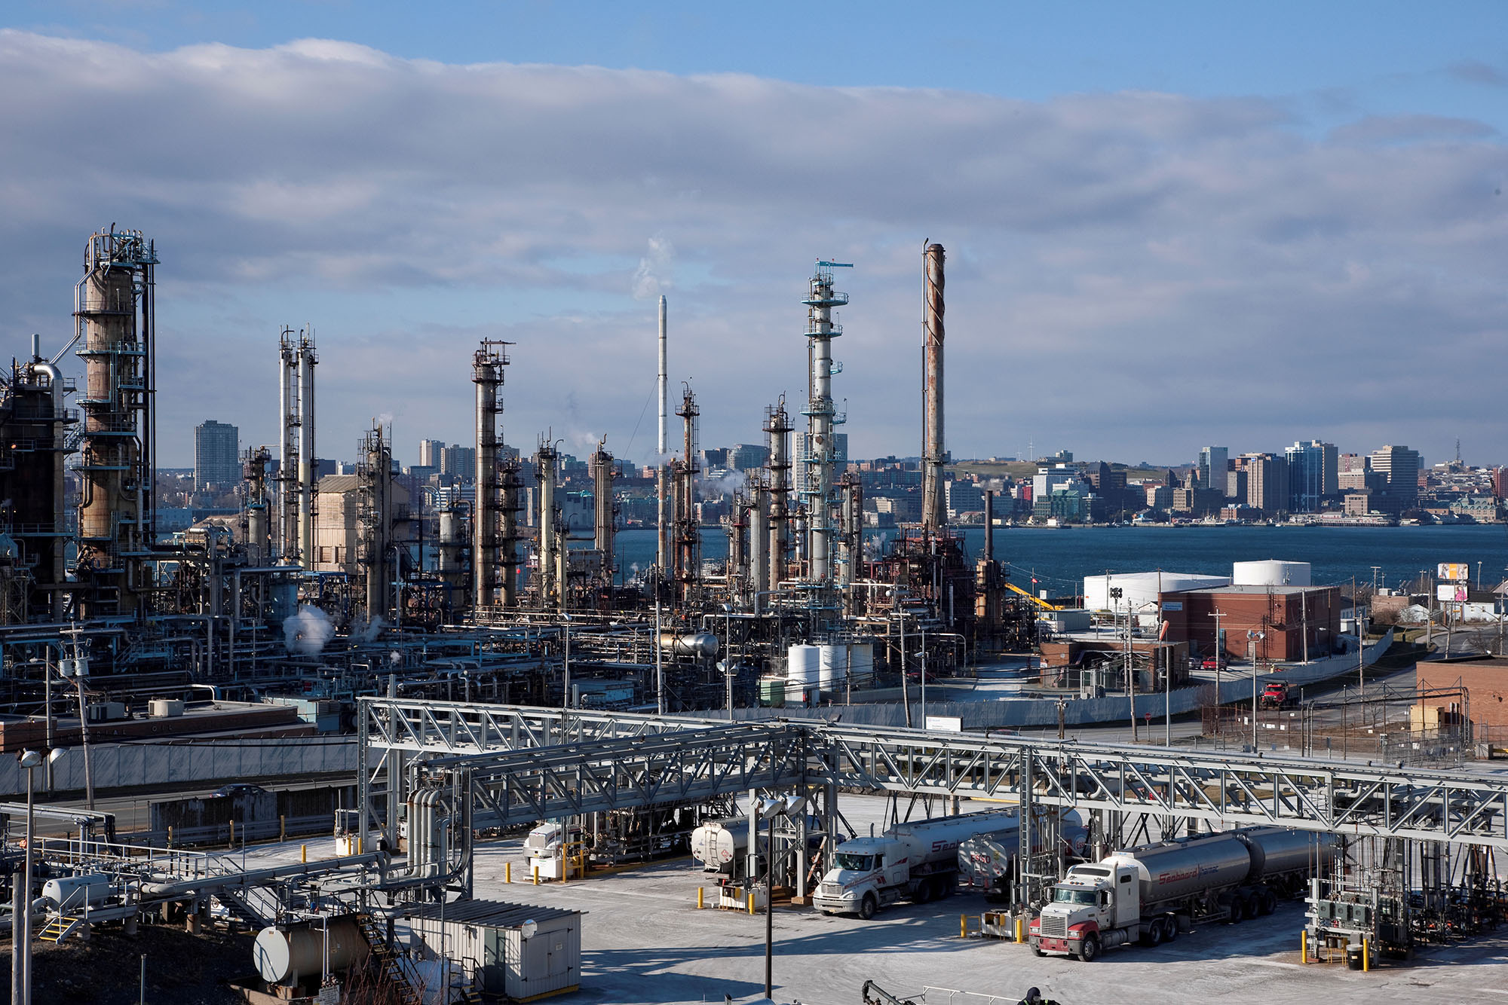
U.S. Crude Export Restrictions
Industry Responses and Impacts
NY Energy Forum Presentation
Turner, Mason & Company
New York City
February 24, 2014

Slide 2

Presenter
John R. Auers, P.E.
Executive Vice President
Univ. of Nebraska Chem. Engr.
Univ. of Houston MBA
Formerly with Exxon
Industry studies/analysis, forecasting, modeling
Leads Outlook team
Contact Info – jauers@turnermason.com
Office – 214-223-8887

Slide 3
TM&C Overview
International practice since 1971
Provides engineering and management consulting for petroleum industry
Downstream focus
Industry and financial clients
Economic and feasibility studies, corporate strategic planning, FMV assessments, due diligence, venture development, etc
Publish various outlook and forecast products

Slide 4
Agenda
The Policy
The Coming “Day of Reckoning”
Impacts
Industry Responses
Final Thoughts

Slide 5
THE POLICY

Slide 6


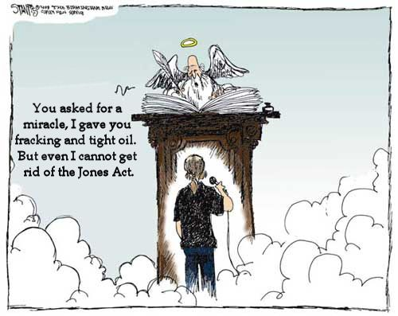
Crude Export Debate

Slide 7
Two Sides of the Barrel
Support Export Restrictions
Oppose Export Restrictions
Consumption State Politicians
  Sen. Ed Markey (MA)
  Sen. Robert Menendez (NJ)
Pro Labor, Pro Consumer
  Center for American Progress
  AFL-CIO
Refiners
  Valero, Tesoro, Monroe Energy, PBF Energy
Bill O’Reilly
Producing State Politicians
  Sen. Lisa Murkowski (AK)
  Sen. Mary Landrieu (LA)
Independent Producers
Integrated Producers/Majors
  Exxon, Chevron
Free Market Supporters
  Council on Foreign Relations
  American Petroleum Institute
  Economist Bill Nordhaus (Yale)
  Cato Institute

Slide 8
Opposing Sides, Some Quotes
Support Export Restrictions
Oppose Export Restrictions
Bill Day, Valero: “The current situation is working fine…we buy oil and take it to our refineries, turn it into gasoline, diesel and other refined fuels since those are higher-valued products that help decrease the trade deficit.”
Graeme Burnett, Chairman Monroe Energy: “The export ban works”
Sen. Ed Markey: “If we overturn decades of law and send our oil to China and other markets, oil companies might make more money per barrel, but it will be American consumers and our national security that will pay the price.”
Center for American Progress Report: “The oil industry would squander this newfound price stabilization and energy security by lifting the ban on crude oil exports. Doing so would enrich oil companies by enabling them to sell their oil at the higher world price, but it could increase domestic gasoline prices and reduce our energy security.”
Harold Hamm, CEO Continental Resources: “Major oil companies are exporting refined products with no limitations. Why shouldn’t independent producers be allowed to do the same? Are we to be their milk cows forever? This would be equivalent to telling American farmers they can’t export their wheat, yet allowing Pillsbury to export all the processed flour they want.”
Kenneth Cohen, ExxonMobil: “…the market has moved from an era of scarcity to an era of abundance -- but we’re still saddled with statutes and regulations stuck in a mindset of scarcity…”
Sen. Mary Landrieu, Chair Senate Energy Committee: “Now that we have more open trade opportunities, and we are producing more here, it just makes absolute perfect sense to reconsider this policy and update it according to the times.”
Blake Clayton, Council on Foreign Relations: “Without compelling reasons for continuing to restrict crude exports, and given the potential benefits, Congress should liberalize the crude oil export regime.”

Slide 9
Petroleum Export Regulations
Crude Oil
Liquid hydrocarbons from
underground reservoirs that
have not been processed through a crude distillation unit
Intermediates
/ Products
Export
License
Required
Outlined in 1975 Energy Policy and Conservation Act and
1979 Export Administration Act
Export
License
Not Required
Pre-Approved
Alaska Crude/US flagged vessels for ANS
To Canada/local use
Heavy California crude/25 MBPD
Case by Case
Presidential determination that it is consistent with national interest

Slide 10
Export Restrictions Have Been Irrelevant
U.S. Production peaks in 1970.
Demand peaks around 2005, falls in 2008-2009 due to recession.
Alaska North Slope peaks in 1988, begins to decline.
Alaska North Slope begins production.
U.S. oil consumption begins to fall.
In coming decades, US oil production continues to fall, while demand increases. Imports grow.
Decline in production, coupled with increasing demand is made up with imports.
Saudis flood market with inexpensive oil beginning in 1985. Oil prices fall over 50% in 1986.

Slide 11
U.S. Crude Oil Exports
Three-month Rolling Averages
Prior to 1993, no destination specific data available.
November 2013
202 MBBL/D
Asia = aggregate of China, Hong Kong, Japan, Korea, Taiwan

Slide 12
“THE DAY OF RECKONING”
WHEN THE U.S. HITS THE “CRUDE WALL”

Slide 13
Shale Crude Boom Has Changed the Picture
Overall Imports down by 2MM BPD in the last 4 years
U.S. production reverses course; increases by 60% since 2008
Waterborne (non Canadian) imports drop off nearly 3MM BPD
Canadian production grows strongly, imports increase

Slide 14

U.S. Light/Medium Waterborne Imports
(Millions of Barrels per Day)
Displaced Crude | MMBBL/D
PADD 3 Light Sweet | 1.3
PADD 1 Light Sweet | 0.6
PADD 2 Total | 0.3
Total Light Sour/Med | 0.6
Total | 2.8

Slide 15
Factors Influencing “Day of Reckoning”
Actual Level of Production Growth
  Estimates vary widely – from 2 MMBPD to 6 MMBPD over the next ten years
Ability to Expand Exports to Canada
  2013 Light/Medium Waterborne (non-U.S.) Imports into Canada > 500 MBPD
  2013 Light/Medium Imports into U.S. from Canada = 1.0 MMBPD
  Dependent on build-out of Canadian pipelines to Tidewater/Canadian policy regarding importing U.S. oil/exporting Canadian oil
Ability to Access West Coast Markets
  This would also influence economics for exporting ANS
  California Low Carbon Fuel Standard (LCFS) /other regulations will also impact access
Ability of U.S. Refining System to Displace Lt. Sour/Medium Crudes
  Very dependent on Saudi willingness to decrease imports
Level of U.S. Processing Additions
  TM&C estimate is currently at about 500 MBPD over next 3 years
The U.S. Gulf Coast Will be the Pivotal Region

Slide 16
Dispositions for Excess U.S. Production
Theoretical Best Case Scenario
*Incremental crude production in excess of refinery/splitter additions

Slide 17
Dispositions for Excess U.S. Production
TM&C More Likely Scenario

Slide 18
Waterborne Imports
TM&C Estimate from Recent Study
Location/Grade | 2017 | 2022 – Structural Minimum
PADD I | 55 | 0
PADD III Lt. Sour/Med. | 190 | 190
PADD III Heavy | 2,058 | 1,100
PADD V Light | 70 | 0
PADD V Med./Heavy | 357 | 150
Total | 2,730 | 1,440

Slide 19
Foreign Producer U.S. Capacity
Company | Location | Foreign Entity | Capacity | Percent
CITGO | Lemont, IL | PDVSA | 159 | 100
CITGO | Lake Charles, LA | PDVSA | 440 | 100
CITGO | Corpus Christi, TX | PDVSA | 157 | 100
Motiva | Port Arthur, TX | Saudi Aramco | 600 | 50
Motiva | Convent, LA | Saudi Aramco | 227 | 50
Motiva | Norco, LA | Saudi Aramco | 220 | 50
Pasadena Ref. | Pasadena, TX | Petrobras | 117 | 100
Shell Deer Park | Deer Park, TX | PEMEX | 327 | 50
Chalmette Ref. | Chalmette, LA | PDVSA | 189 | 50
Total |  |  | 2,436 | 1,660*
*Foreign ownership weighted capacity

Slide 20
IMPACTS

Slide 21
Impacts of Export Restrictions
Requires crude production growth to be processed domestically
  Make the entire U.S. an effectively “stranded” location (similar to Cushing) and create price discounts
  Spur new investment in crude processing
  Redefine (again) optimal industry logistical movements
  Increase refined product exports
Price discount trajectory/levels
  Discounts “blow out” when all non-structural light/medium WB imports displaced
  Investment delayed due to regulatory uncertainty
  Ultimately discounts decline to levels based on marginal industry investment type

Slide 22
Price Response Timeline
2014-2015
  Relatively minimal impact on prices from export restrictions as domestic crude continues to displace waterborne imports
2016-2021
  The effects of restricted exports starts to become apparent.
  Domestic discounts become very volatile as U.S. becomes a stranded location
  Refining and Midstream respond with “crude-to-product” projects
2022+
  Crude pricing volatility decreases
  Differentials settle at a level providing breakeven economics for marginal industry investment type (USGC WTI hydroskimmer)

Slide 23
LLS-WTI Experience

Slide 24

Domestic-to-International Discount
Brent (Dated) – LLS (St James) Forecast
Increasing volatility during transition.
LLS transitions to permanent discount as light crude imports disappear.
  Eventually discount declines
  to level based on investment economics
Large “Cone of Uncertainty” - substantial volatility
?
At import parity through 2010
???

Slide 25
Heavy/Light Discount
LLS (St James) – Maya (FOB) forecast
  Western Hemisphere heavy crudes indirectly impacted by U.S. export restrictions as markets in the rest of the world are limited
  Estimated impact less than for domestic light crudes
  $6 to $8 per barrel “floor” based on level necessary to incentivize USGC coking refineries to run heavy crudes

Slide 26
INDUSTRY RESPONSES

Slide 27
Industry Response
Increase Refinery Utilization
  PADDs I, III, and V can absorb additional 400 MBPD of light crude
  Incentivized by large domestic to international crude discounts
  PADD V would need improved logistics to access tight oils
  Will delay/reduce required new processing investment
Refinery Investment
  Two timeframes: Current to 2018 and 2018 and beyond
  Current to 2018 investment required regardless of export policy
  Both refiners and midstream players will participate
  Heavy-to-Light Refinery Conversions limited
  Will cause significant increase in U.S. product exports

Slide 28
Increased Refinery Utilization Likely
Potential for PADDs I, III & V to absorb 400 MBPD additional light crude oil
Increased refinery runs will delay/reduce required new processing investments
PADD III refineries will still need new ULSD investment but may avoid new distillation and sulfur recovery
In the case of PADD I & PADD V, significant discounts will still be needed to incentivize increased runs
PADD V will likely need Permian Basin-LA pipeline to be economic

Slide 29
Heavy-to-Light Conversions Unlikely
Western Hemisphere heavy crude reserves will continue to grow
  Production is economic under our expected price environment
Producers will price crude to keep heavy oil refineries fully utilized on a sustainable basis
  Proactive to “lock in” refining capacity via joint ventures and long-term contracts
Heavy-to-light conversion investment not competitive with other alternatives (i.e., grassroots hydroskimmer) under expected light/heavy differentials
Heavy crude refiners are making investments to provide “optionality” and will run light crude at times when spread goes below economic floor

Slide 30
Growth in U.S. Net Product Exports
2013 to 2022

Slide 31
Industry Investments
Current to 2018
Provide ability to run very light crudes and condensates
Most being done within refinery gates
  Focused on Eagle Ford; also some Utica
  Refinery specific
  Pre-flash towers, new atmospheric units
  Condensate splitters and condensate hydroskimmers by midstream players
Total level of required investments exceed $2 billion
  Excludes regional “opportunistic” investments

Slide 32
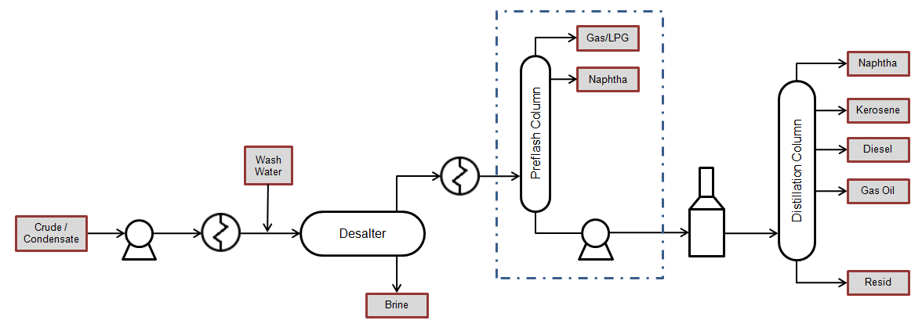
Pre-Flash Column Process Flow

Slide 33
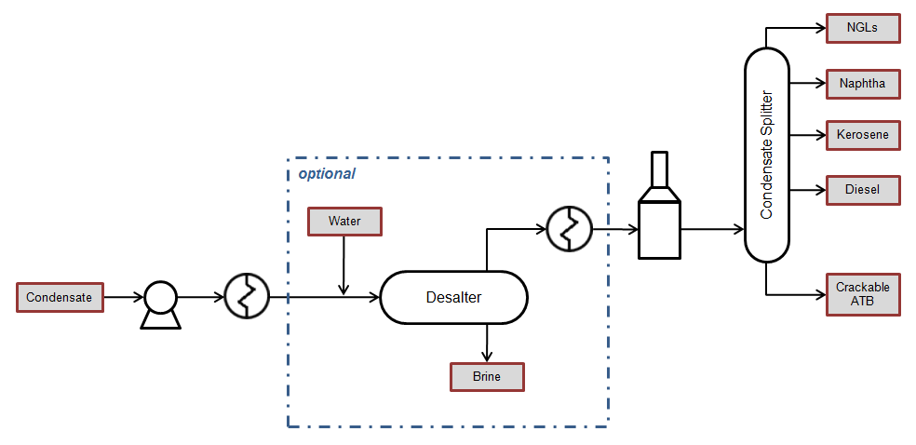
Condensate Splitter Process Flow
optional

Slide 34
Refinery Expansions
Required Crude Expansions
Operator | Location | MBPD* | Startup
Flint Hills | Corpus Christi | 30 | Late 2014
Valero | Houston | 90 | 2Q 2015
Valero | Corpus Christi | 70 | 3Q 2015
Marathon | Canton, OH | 10 | 2014
Marathon | Catlettsburg, KY | 35 | 2015
Opportunistic Crude Expansions
Operator | Location | MBPD | Startup
Dakota Prairie Refining/Calumet | Dickinson, ND | 20 | 2014-2015
Valero | McKee, TX | 25 | 2015
HollyFrontier | Woods Cross, UT | 14 | 2015
Calumet | Great Falls, MT | 10 | 2015
Tesoro | Salt Lake City | 4 | 2015
*Project will allow refinery to run higher volumes of very light crude and condensate from regional tight oil production. Estimated total expansion of crude capacity is not necessarily equal to capacity of new condensate splitter or preflash tower and is TM&C's estimate.

Slide 35
Condensate Splitters
Under Construction
Operator | Location | MBPD | Startup
Kinder Morgan, Phase 1 | Houston | 50 | 1Q 2014
Kinder Morgan, Phase 2 |  | 50 | 2Q 2015
Trafigura | Corpus Christi | 50 | 4Q 2014
Proposed
Operator | Location | MBPD | Startup
Magellan Midstream | Corpus Christi | TBD | TBD
Martin Midstream | Corpus Christi | Up to 100 | 1-2Q 2016
Targa Resources | TBD | TBD | TBD
Castleton Commodities | Corpus Christi | TBD | TBD

Slide 36
Industry Investments
2018+
Made to convert crude to “exportable” products
Various types – condensate splitters/expansions, diesel HDS additions, Eagle Ford and WTI hydroskimmers
Expect over $4 billion of total investment
Midstream segment likely to sponsor many projects
Economics highly sensitive to naphtha and atmospheric tower bottoms (ATB) prices
USGC WTI Hydroskimmer will be “price-setter”

Slide 37
Prioritization of Industry Responses
Priority | Project
1 | Increase USGC Utilization
2 | USGC Refinery Add-On Hydroskimmer
3 | Increase USWC Utilization – Pipeline $8/bbl
4 | Increase USAC Utilization
5 | Greenfield USGC Hydroskimmer
 | Increase USWC Utilization – Rail >$10/bbl
 | Heavy Crude Refinery Revamp w/ ULSD

Slide 38
Why Hydroskimmers
Low investment/Uncomplicated operation
No incentive to add to gasoline surplus
Producing ULS diesel adds value
U.S. demand can absorb atmospheric tower bottoms (ATB) and some heavy naphtha
Mid-stream players will be quickest to react and could proceed on a “for fee” basis
Ultimate economic impact will be highly sensitive to naphtha and ATB netbacks

Slide 39
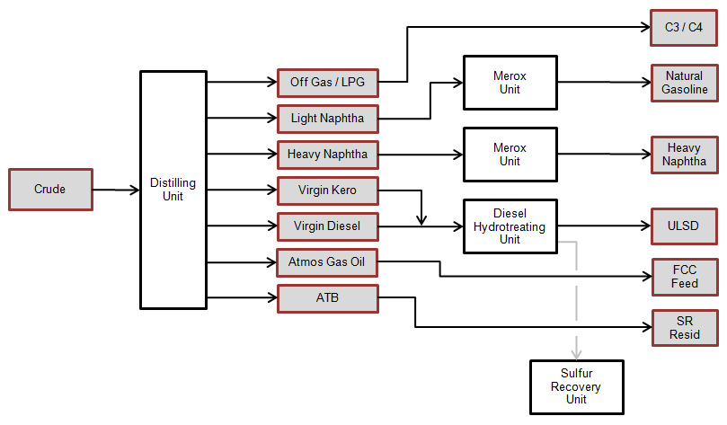
WTI Hydroskimmer Block Flow

Slide 40
Final Thoughts
U.S. Production Growth Will Surpass Domestic Refining Capacity
  “Day of Reckoning” not likely till at least 2016/perhaps not till 2020+
  Influenced by a variety of factors
Continued Export Restrictions will Lead to “Stranded Crude”
  Domestic prices discounted; situation similar to WTI/LLS experience
  Large “Cone of Uncertainty” - Duration and depth of discount hard to predict; very volatile
Industry Responds with Investment in Crude-to-Product Facilities
  Investment delayed by policy uncertainty
  Export vs. No Export price impact reduced to level equal to investment economics
Gasoline Price Impacts
  With U.S. becoming large net exporter, domestic prices tied to world prices
  Short-term impacts hard to predict; influenced by logistics/other policies

Slide 41
Questions?

